Slide 2
Pot

Slide 3
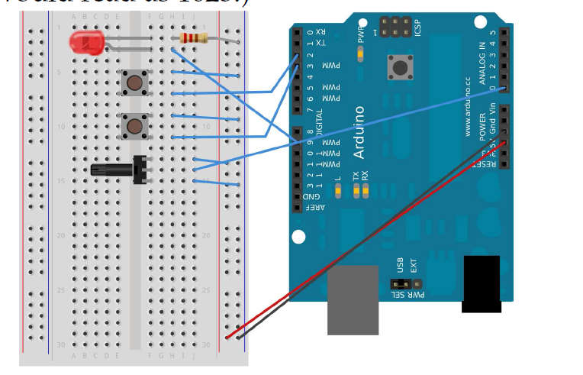

Slide 4
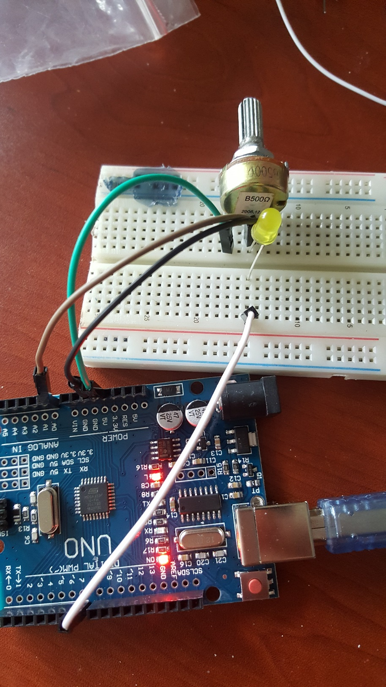

Slide 6
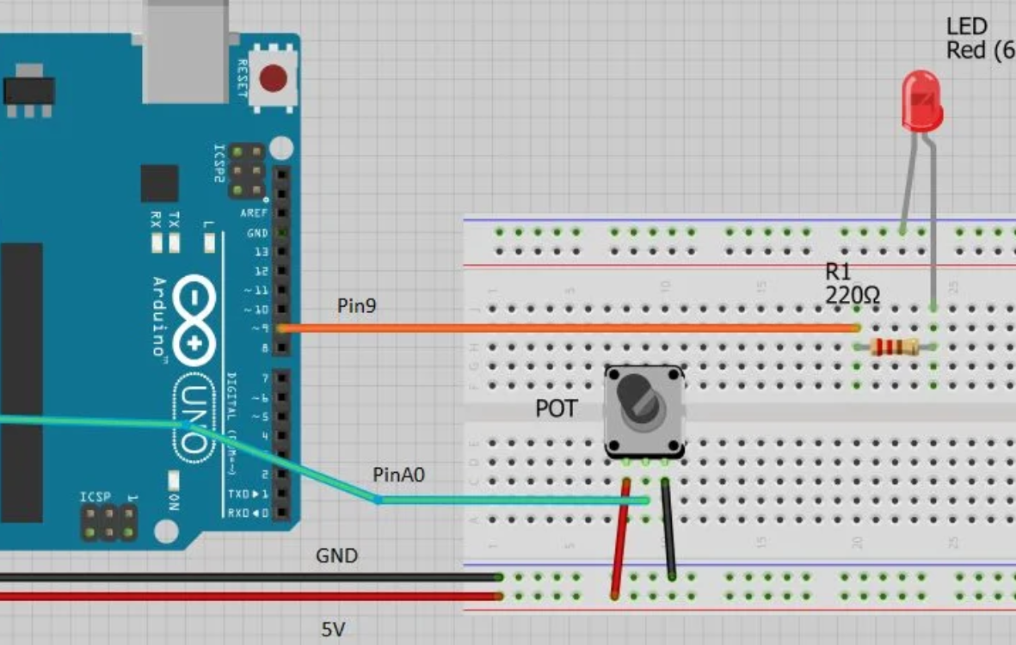

Slide 7
int sensorPin = A0; // select the input pin for the potentiometer
int ledPin = 7; // select the pin for the LED
int sensorValue = 0; // variable to store the value coming from the sensor
void setup() {
pinMode(ledPin, OUTPUT);
}
void loop() {
// read the value from the sensor:
sensorValue = analogRead(sensorPin);
// turn the ledPin on
digitalWrite(ledPin, HIGH);
// stop the program for <sensorValue> milliseconds:
delay(sensorValue);
// turn the ledPin off:
digitalWrite(ledPin, LOW);
// stop the program for for <sensorValue> milliseconds:
delay(sensorValue);
}

Slide 8
Sound active or passive buzzer

Slide 9
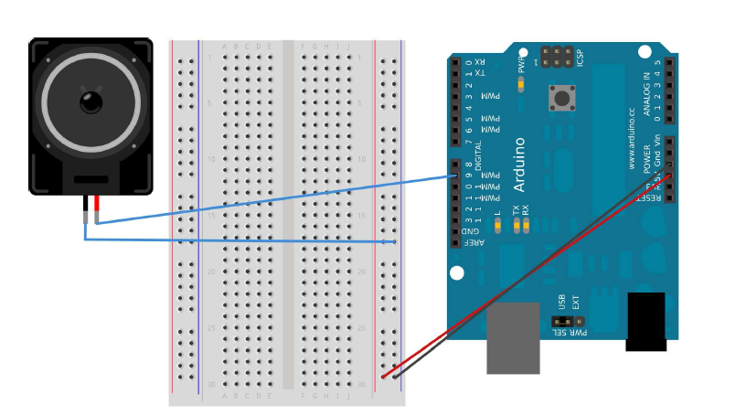

Slide 10
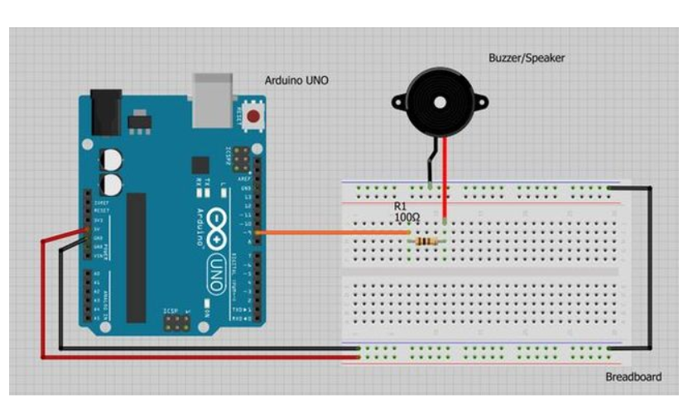

Slide 11
const int buzzer = 9; //buzzer to arduino pin 9
void setup(){
pinMode(buzzer, OUTPUT); // Set buzzer - pin 9 as an output
}
void loop(){
tone(buzzer, 1000); // Send 1KHz sound signal...
delay(1000); // ...for 1 sec
noTone(buzzer); // Stop sound...
delay(1000); // ...for 1sec
}

Slide 12
tone
void setup() {
pinMode(4, OUTPUT);
beep(50);
beep(50);
beep(50);
delay(1000);
}
void loop() {
beep(200);
}
void beep(unsigned char delayms){
tone(4, 2000);
delay(delayms);
tone(4, 0);
delay(delayms);
}

Slide 13
melodi
int buzzerPin = 4;
int notaSayisi = 8;
int C = 262;
int D = 294;
int E = 330;
int F = 349;
int G = 392;
int A = 440;
int B = 494;
int C_ = 523;
int notalar[] = {C, D, E, F, G, A, B, C_};
void setup() {
for (int i = 0; i < notaSayisi; i++)
{
tone(buzzerPin, notalar[i]);
delay(500);
noTone(buzzerPin);
delay(20);
}
noTone(buzzerPin);
}
void loop() {
}

Slide 14
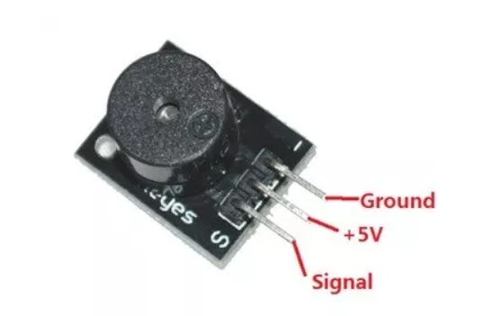

Slide 15
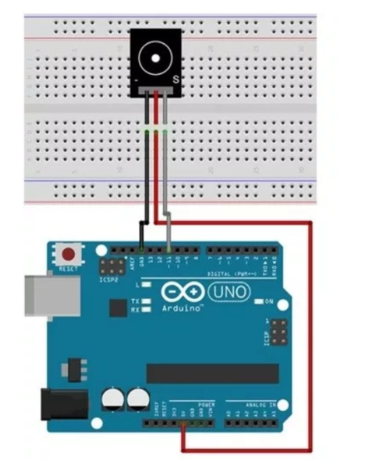

Slide 16
Passive buzzer
int out =4; // initializing pin 11 as buzzer pin
void setup () { // Code written in it will only run once.
pinMode(out, OUTPUT); // Setting pin 11 as output pin
}
void loop () { // Code written in it will run repeatedly
unsigned char i, j ; // Declaring variables
while (1){
for (i = 0; i <80; i++){ // 100 cycles of sound
digitalWrite (out, HIGH); // This will turn the buzzer ON
delay (1) ; // Giving a Delay of 1ms will set frequency 1
digitalWrite (out, LOW); // This will turn the buzzer OFF
delay (1) ; // Giving a delay ms
}
for (i = 0; i <100; i++){ // 100 cycles of sound
digitalWrite (out, HIGH); // This will turn the buzzer ON
delay (2) ; // Giving a delay of 2ms will set frequency 2
digitalWrite (out, LOW); // This will turn the buzzer OFF
delay (2) ; // Giving a delay of 2ms
}
}
}

Slide 17
display

Slide 18
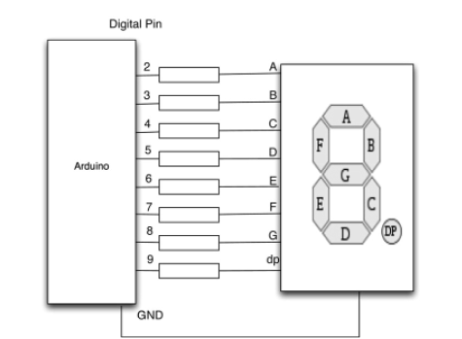

Slide 20
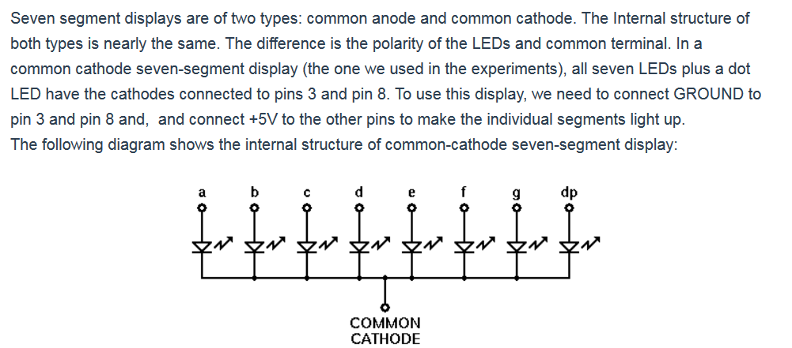

Slide 21
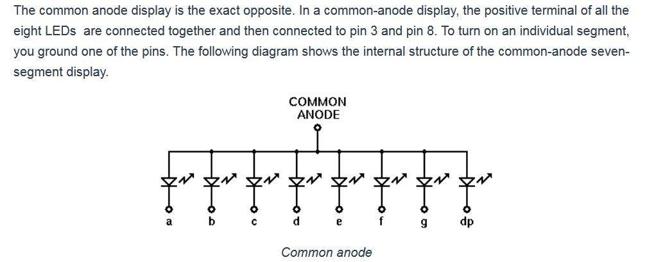

Slide 22
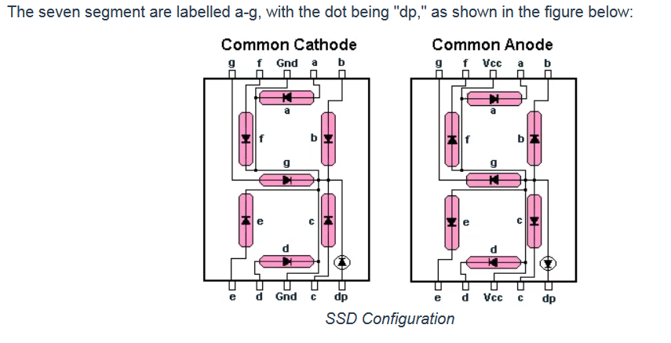

Slide 23
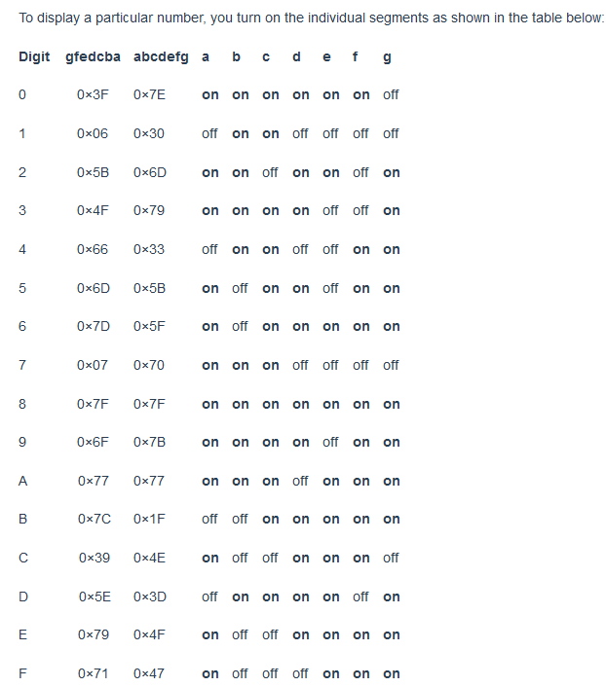

Slide 24
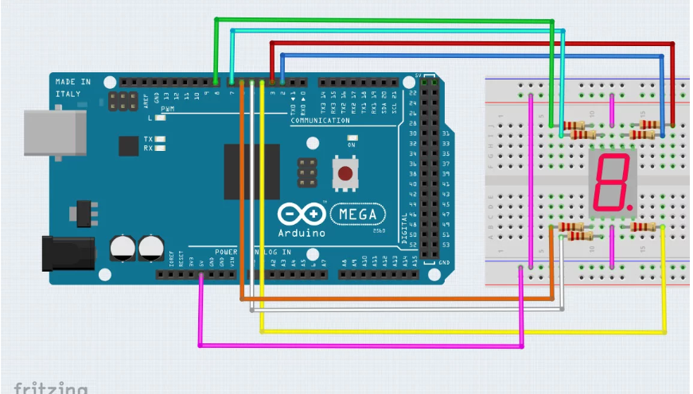

Slide 26
Temprature measure

Slide 27
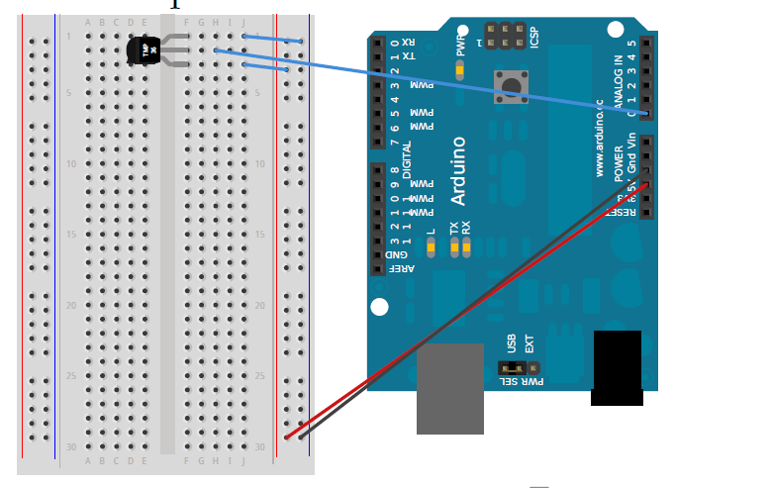

Slide 28
LCD monitor

Slide 29
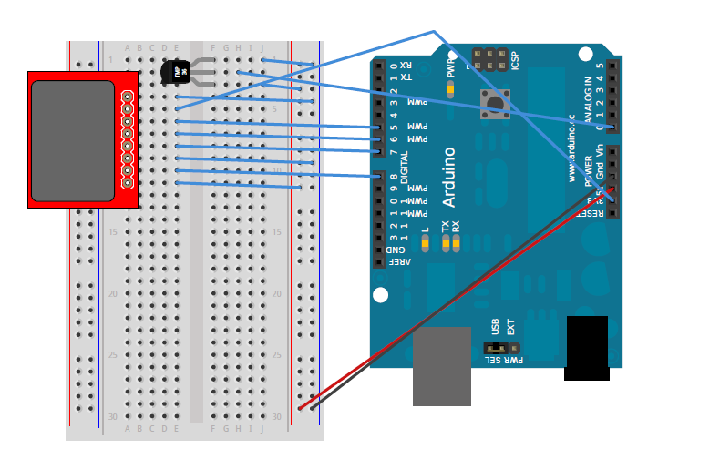

Slide 30
Light sensor

